Slide 1
UNIT-I Data Mining
Prepared By
Mr. Rubul Kumar Bania
Asst.Professor
Dept. computer Application, NEHU, Tura Campus

Slide 2
What is Data Mining?
Data mining (knowledge discovery in databases):
Extraction of interesting (non-trivial, implicit, previously unknown and potentially useful) information or patterns from data in large databases
Alternative names and their “inside stories”:
Data mining: a misnomer?
Knowledge discovery(mining) in databases (KDD), knowledge extraction, data/pattern analysis, data archeology, data dredging, information harvesting, business intelligence, etc.
What is not data mining?
(Deductive) query processing.
Expert systems or small ML/statistical programs

Slide 3
What is Data Mining?
Alternatively, others view Data mining as simply essential step in the process of knowledge discovery.
Knowledge discovery as a process is depicted in Figure-1 and consists of an iterative sequences of the following steps:
1. Data cleaning
2. Data integration
3. Data selection
4. Data Transformation
5. Data Mining
6. Pattern evaluation
7. Knowledge Representation.
Data Preprocessing

Slide 4
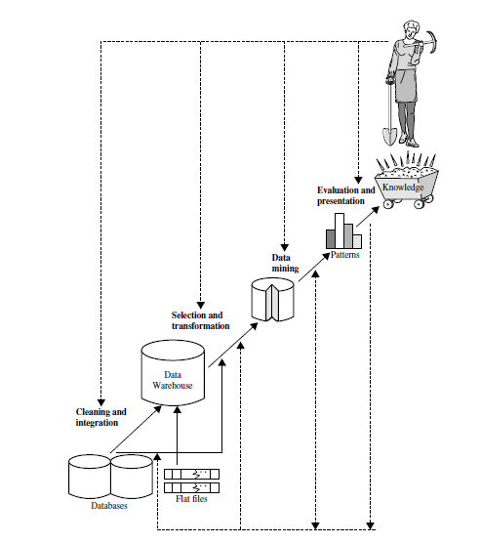
Figure 1: KDD process

Slide 5
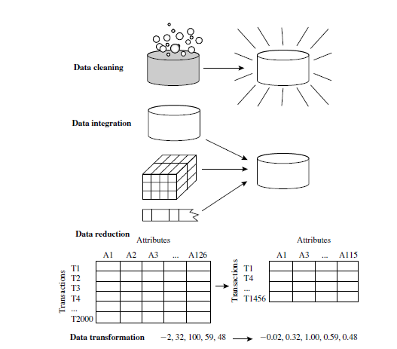
Data Preprocessing

Slide 6
Data Preprocessing
Data Cleaning:
Missing value
(Ignore the tuples, Fill in the missing value manually, Use a global constant fill the missing value etc).
Noisy Data
(Binning, Regression, Clustering)
Inconsistency
Data Integration:
Entity identification problem

Slide 7
Data Preprocessing
Data transformation:
In data transformation, the data are transformed or consolidated into forms appropriate for mining.
Smoothing
Aggregation
Normalization
Attribute construction

Slide 8
Data Preprocessing
Data Reduction
Data reduction techniques can be applied to obtain a reduced representation of the data set that is much smaller in volume, yet closely maintain the integrity of the original data.
Attribute(feature) subset selection
Data cube aggregation

Slide 9
Data mining:
An essential process where intelligent methods are applied in order to extract data patterns.
Pattern evaluation
To identify the truly interesting patterns repressing knowledge based on some interestingness measures.
Knowledge presentation
Where visualization and knowledge representations techniques are used to present the minded knowledge to the user.

Slide 10
Data mining- on what kind of Data?
Number of different data repositories on
which mining can be performed:
- Flat files, Relational databases, Data warehouses, advanced database systems, data streams and the world wide web.
- Advanced database systems: Object-relational databases and specific application-oriented databases, such as spatial databases, time-series databases, multimedia data etc.

Slide 11
Relational databases
A relational database is a collection tables, each of which assigned a unique name. Each table consists of a set of attributes and usually stores a large set of tuples. Each tuples represents an object identified by a unique key and described by a set of attribute values.
A relational database for AllElectronis:
Say, relation tables are: customer, item, employee and branch.
Relational database can be accessed by database queries.

Slide 12
Data Mining Functionalities (1)
Concept description: Characterization and discrimination
Generalize, summarize, and contrast data characteristics, e.g., dry vs. wet regions
Association (correlation and causality)
Multi-dimensional vs. single-dimensional association
age(X, “20..29”) ^ income(X, “20..29K”) à buys(X, “PC”) [support = 2%, confidence = 60%]
contains(T, “computer”) à contains(x, “software”) [1%, 75%]

Slide 13
Data Mining Functionalities (1)
Classification and Prediction
Finding models (functions) that describe and distinguish classes or concepts for future prediction
E.g., classify countries based on climate, or classify cars based on gas mileage
Presentation: decision-tree, classification rule, neural network
Prediction: Predict some unknown or missing numerical values
Cluster analysis
Class label is unknown: Group data to form new classes, e.g., cluster houses to find distribution patterns
Clustering based on the principle: maximizing the intra-class similarity and minimizing the interclass similarity

Slide 14
Data Mining Functionalities (1)
Outlier analysis
Outlier: a data object that does not comply with the general behavior of the data
It can be considered as noise or exception but is quite useful in fraud detection, rare events analysis
Trend and evolution analysis
Trend and deviation: regression analysis
Sequential pattern mining, periodicity analysis
Similarity-based analysis
Other pattern-directed or statistical analyses

Slide 15
Transactional database
Transactional database consists of a file where record represents a transaction. Transaction typically includes unique transaction ID with a list of items purchased.
It may have additional tables associated with it, which contain other information regarding the sale, such as the date of the transaction, the customer ID, the ID of sales Person, branch etc.

Slide 16
Transactional Database
As an analyst of the AllElectonics database:
Put a query
“Show me all the items purchased by Sandy”
Answering such query may require a scan of the entire database.
Now, “Which items sold well together?”
- Market basket analysis needed.

Slide 17
Data warehouse
Suppose that AllElectronis is a successful international company, with branches around the globe. Each branch has its own set of databases.
If the CEO, asked the analyst “to provide an analysis of the company’s sale per item per branch for the third quarter of the year.”
Difficult Task?

Slide 18
Data warehouse
If All Electronics had a data warehouse this task would be easy.
What is Data-Warehouse?
It is a repository of information collected from multiple sources , stored under a unified schema and that usually resides in single site.
Data warehouses are constructed via a process of data cleaning, integrating, transforming, loading and periodic data refreshing.

Slide 19
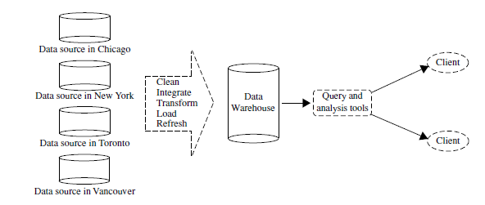
Data warehouse
Fig: Typical framework of a data warehouse for AllElectronics.

Slide 20
What is Data Warehouse?
Defined in many different ways, but not rigorously.
A decision support database that is maintained separately from the organization’s operational database
Support information processing by providing a solid platform of consolidated, historical data for analysis.
“A data warehouse is a subject-oriented, integrated, time-variant, and nonvolatile collection of data in support of management’s decision-making process.”—W. H. Inmon
Data warehousing:
The process of constructing and using data warehouses

Slide 21
Data Warehouse—Subject-Oriented
Organized around major subjects, such as customer, product, sales.
Focusing on the modeling and analysis of data for decision makers, not on daily operations or transaction processing.
Provide a simple and concise view around particular subject issues by excluding data that are not useful in the decision support process.

Slide 22
Data Warehouse—Integrated
Constructed by integrating multiple, heterogeneous data sources
relational databases, flat files, on-line transaction records
Data cleaning and data integration techniques are applied.

Slide 23
Data Warehouse—Time Variant
The time horizon for the data warehouse is significantly longer than that of operational systems.
Operational database: current value data.
Data warehouse data: provide information from a historical perspective (e.g., past 5-10 years)

Slide 24
Data Warehouse—Non-Volatile
A physically separate store of data transformed from the operational environment.
Operational update of data does not occur in the data warehouse environment.
Does not require transaction processing, recovery, and concurrency control mechanisms
Requires only two operations in data accessing:
initial loading of data and access of data.

Slide 25
Differences between Operational Database Systems and Data Warehouses
The major task of online operational database systems is to perform online transaction and query processing. These systems are called online transaction processing (OLTP) systems. They cover most of the day-to-day operations of an organization such as purchasing, inventory, manufacturing, banking, payroll, registration, and accounting.
Data warehouse systems, on the other hand, serve users or knowledge workers in the role of data analysis and decision making. Such systems can organize and present data in various formats in order to accommodate the diverse needs of different users. These systems are known as online analytical processing (OLAP) systems.

Slide 26
OLTP vs OLAP
Users and system orientation
Data contents
Database design
Access patterns

Slide 27
Model-data cube
A data warehouse is usually modeled by a multidimensional data structure, called a data cube, in which each dimension corresponds to an attribute or a set of attributes in the schema, and each cell stores the value of some aggregate measure such as count or sum( sales_amount).
A data cube provides a multidimensional view of data and allows the pre-computation and fast access of summarized data.

Slide 28
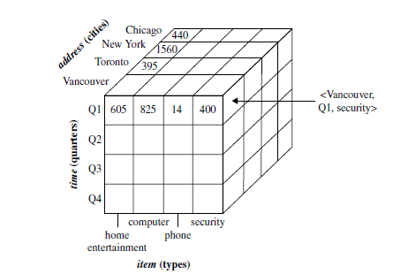
A data cube for AllElectronics
A data cube for summarized sales data of AllElectronics is presented in Figure .
The cube has three dimensions: address (with city values
Chicago, New York, Toronto, Vancouver), time (with quarter values Q1, Q2, Q3, Q4), and
item(with itemtype values home entertainment, computer, phone, security).
The aggregate value stored in each cell of the cube is sales_amount.

Slide 29
Conceptual Modeling of Data Warehouses
Modeling data warehouses: dimensions & measures
Star schema: A fact table in the middle connected to a set of dimension tables.
Fact table contains detailed summary data.
Each dimension is a single highly normalized table.
Every tuple in the fact table consists of the fact or subject of interest, and the dimensions that provide that fact.
Advantage of star schema is that it is easy to understand, easy to define hierarchies, requires low maintenance and very simple metadata.

Slide 30
Example of Star Schema
time
time_key
day
day_of_the_week
month
quarter
year
item
item_key
item_name
brand
type
supplier_type
Sales Fact Table
time_key
item_key
branch_key
branch
location
location_key
branch_key
branch_name
branch_type
location_key
street
city
state_or_province
country
units_sold
dollars_sold
avg_sales
Measures

Slide 31
SNOWFLAKE
Snowflake schema: A refinement of star schema where some dimensional hierarchy is normalized into a set of smaller dimension tables, forming a shape similar to snowflake
Advantage easier to maintain because of normalization, saves storage, no redundant information

Slide 32
Example of Snowflake Schema
time
item
time_key
day
day_of_the_week
month
quarter
year
item_key
item_name
brand
type
supplier_key
supplier
Sales Fact Table
supplier_key
supplier_type
time_key
item_key
branch_key
branch
location
location_key
location_key
street
city_key
branch_key
branch_name
branch_type
units_sold
dollars_sold
city
city_key
city
state_or_province
country
avg_sales
Measures

Slide 33
Fact constellations: Multiple fact tables share dimension tables, viewed as a collection of stars, therefore called galaxy schema or fact constellation

Slide 34
Example of Fact Constellation
time
time_key
day
day_of_the_week
month
quarter
year
item
Shipping Fact Table
item_key
item_name
brand
type
supplier_type
Sales Fact Table
time_key
time_key
item_key
shipper_key
item_key
branch_key
from_location
branch
location_key
location
to_location
branch_key
branch_name
branch_type
units_sold
location_key
street
city
province_or_state
country
dollars_cost
dollars_sold
units_shipped
avg_sales
shipper
Measures
shipper_key
shipper_name
location_key
shipper_type

Slide 35
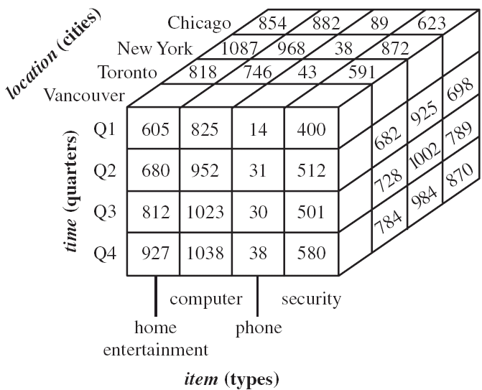
OLAP operations
Slicing: used for reducing the data cube by one or more dimensions. It performs a selection on one dimension (eg. Q1) of the given cube, resulting in a subcube.

Slide 36
OLAP operations
Dicing: used for reducing the data cube by one or more dimensions. It selects a smaller data cube and analyzed it from different perspectives. It defines a subcube by performing a selection on 2 or more dimensions. Eg. A dice operation on the central cube on the following selection criteria, involving 3 dimensions: (location = New York or Toronto) and (time = Q1 or Q2).
Drilling: this operation is meant for moving up & down along classification hierarchies. The different instances of drilling operations may be distinguished as follows:
Drill-up: switches from a detailed to an aggregated level within the same classification hierarchy. Also called roll-up operation, performs aggregation by either climbing up a dimension hierarchy or by dimension reduction.

Slide 37
Drill-down: switches from an aggregated to a more detailed level within the same classification hierarchy. It performs by either stepping down a dimension hierarchy or by introducing additional dimensions.
Drill-within: switches from one classification to a different one within the same dimension;
Drill-across: switches from a classification in one dimension to a different classification in a different dimension
Pivot (rotate): is a visualization operation which rotates the data axes in order to provide an alternative presentation of the same data.

Slide 38
Typical OLAP Operations
Roll up (drill-up): summarize data
by climbing up hierarchy or by dimension reduction
Drill down (roll down): reverse of roll-up
from higher level summary to lower level summary or detailed data, or introducing new dimensions
Slice and dice:
project and select
Pivot (rotate):
reorient the cube, visualization, 3D to series of 2D planes.
Other operations
drill across: involving (across) more than one fact table
drill through: through the bottom level of the cube to its back-end relational tables (using SQL)

Slide 39
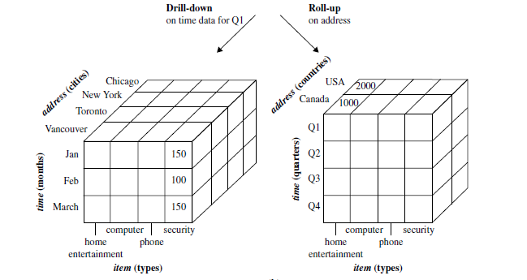
Operations

